Slide 1


SEO Report Q1, 2024
Ideal Jewelry

Slide 2
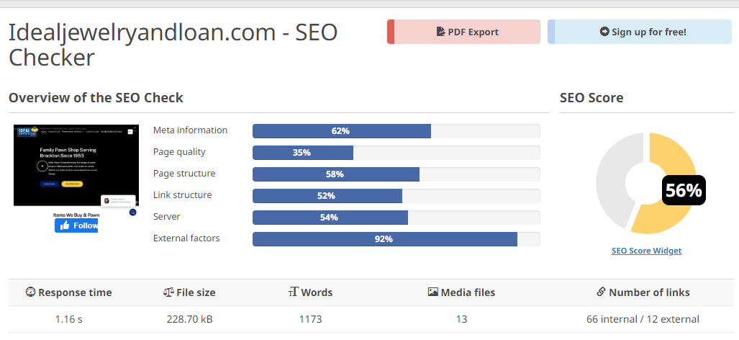
SEO Scores Before
Each website has an SEO score based on many factors that shall be optimized.
The initial score of website was 56% as seen in the report snippet.
The Website in terms of SEO, lacked a lot of improvements to rank better.

Slide 3
A Gradual Process
It is important to understand that SEO is a slow and consistent process.
Our Team worked months to improve these SEO scores and maintained the content .

Slide 4

1.Content creation
For a website to rank better and have more organic traffic requires consistent content posted in a timely order.
We have been maintaining the blog content timely.

Slide 5

2.Optimizing Content
Writing relevant content isn't enough!
Instead, the content must follow some guidelines including a number of descriptive words, strong headings, a proportion of passive resentences and a lot more.
We continuously strive for improvement, ensuring that each upcoming piece of content surpasses its predecessor.

Slide 6
3.Meta Descriptions
In order to rank your website better each web page must have a catchy, concise, and relevant description that drags the user's interest.
All webpages have been described in a beautiful manner to grab user's attention as well as concise enough to fit the browser standards.

Slide 7

4.Keyword research
Keywords play a vital role in ranking a website better.
Your website shall have focus keywords but never be stuffed with them.
There must be a specific ratio maintained between text to keywords.

Slide 8

5.Following the trends
Understanding that people don't always search the same, things change with time.
Molding the user needs along with evolving with market trends is one of the SEO key points.

Slide 9
6.Domain research
Each business niche has its own success and failure points depending on their audience and competitors.
While opting for the website to rank better we need to know the business ground, market trends, and user personas.

Slide 10
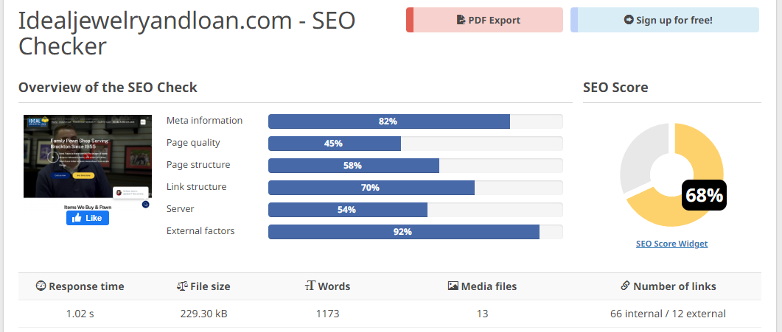
SEO Scores
The SEO score improved to 68% which is a great improvement.

Slide 11
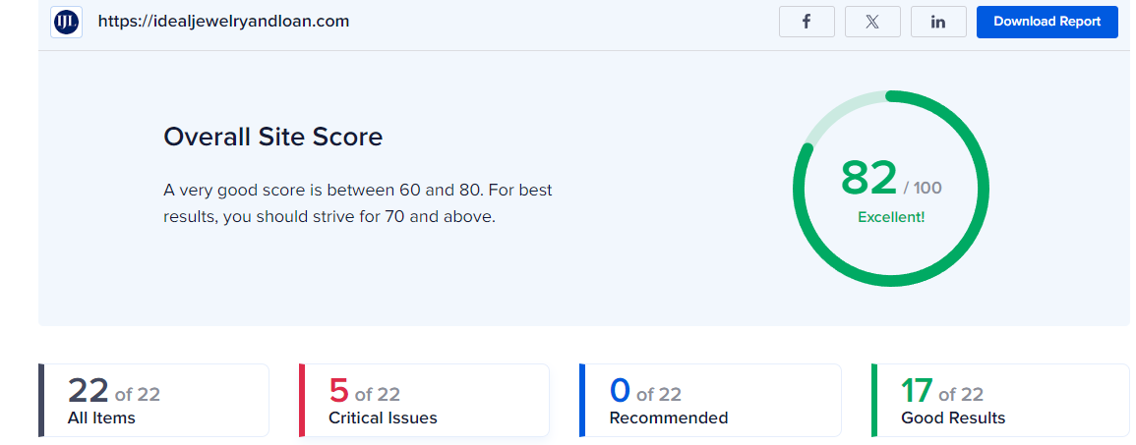
SEO Scores
The SEO score improved to 82% which is a great score

Slide 12
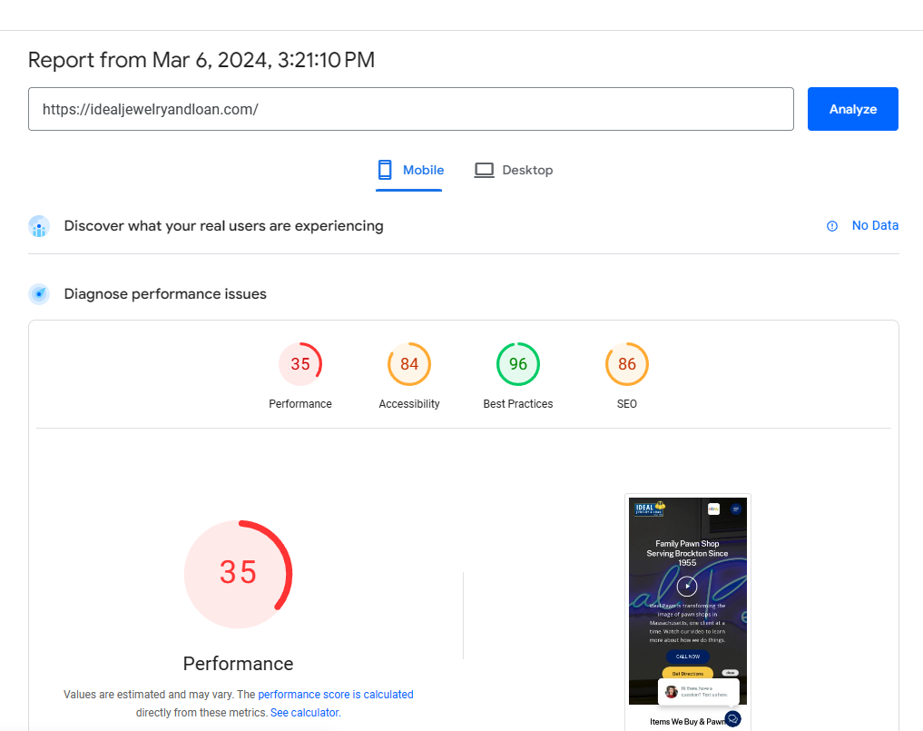
SEO Scores
Now we have made the website 86% optimized for SEO which is superb!
The only thing that lacks behind is performance score due to the server issues, although it isn't Icon’s task, but we can help you guys work in this as well if you’d like using the services of Iconhost.

Slide 13
Can we collaborate to optimize Ideal Jewelry more?

